Slide 1
Welcome Parents and Carers of Year 1 and Year 2
Miss Katrina Lee and Mrs Carol Wadey

Slide 2
Opal class’ adults
Mrs Wadey: Class Teacher (Monday and Tuesday)
Miss Burton: Class Teacher (Wednesday, Thursday and Friday)
Mrs Adams: Teaching Assistant (Every Morning + Monday and Thursday afternoons)
Mrs Greenaway: Teaching Assistant (Monday, Tuesday and Friday mornings)
Miss Degia: Teaching Assistant (afternoons)
Mrs O’Riordan: Teaching Assistant (Monday, Tuesday and Friday afternoons)
Mrs Adams: PPA Monday PM and Thursday PM
COMMUNICATION:
Reading diaries are checked daily so these are the best way of communicating
with the teacher. Or you can email the school office and this will get forwarded on.
Replies will then be forwarded back to you.

Slide 3
Topaz class’ adults
Miss Lee: Class Teacher
Mrs O’Riordan : Teaching Assistant (All mornings & Monday afternoon)
Mrs Adams : Teaching Assistant (Wednesday, Thursday and Friday afternoon)
Mrs Bruce: PPA cover (Monday afternoon)
COMMUNICATION:
Reading diaries are checked daily so these are the best way of communicating
with the teacher. Or you can email the school office and this will get forwarded on.
Replies will then be forwarded back to you.

Slide 4
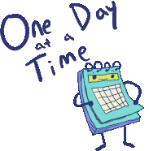
A typical day in Opal Class
PM
AM
Lunch​
​
Register ​
​​
Foundation subject lesson (PE, science, computing, history, music, art etc)
​
​
​Story time ​
​
Home time ​
​
Early learning and register ​
​
Introduce activities for the day ​
​
English whole class input ​ or
​Maths whole class input
​Assembly ​
​
Break time ​
​
​​Exploring Topic, English, Maths and Creative activities
Phonics

Slide 5
A typical day in Topaz Class
AM
Carousel learning activities
Maths, Handwriting, Reading, Fine Motor,
Spelling
Phonics
English
Assembly
Break time
Maths
PSHE / Fluent in 5
PM
Lunch
Register
Quiet Reading + Teacher 1:1 reading
Foundation subject lesson (PE, science, computing, history, music, art etc)
​
Story time
Home time
Notes:
Phonics will continue until the new year. Then children will begin guided reading and spellings.

Slide 6
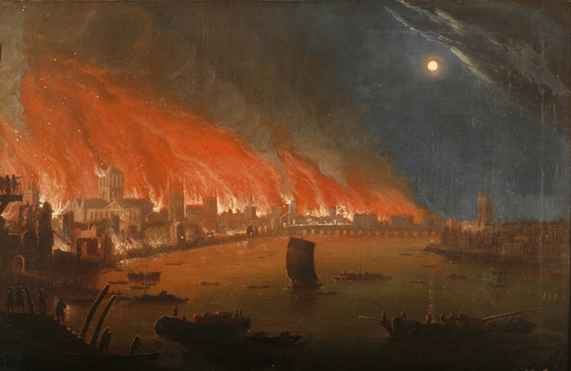
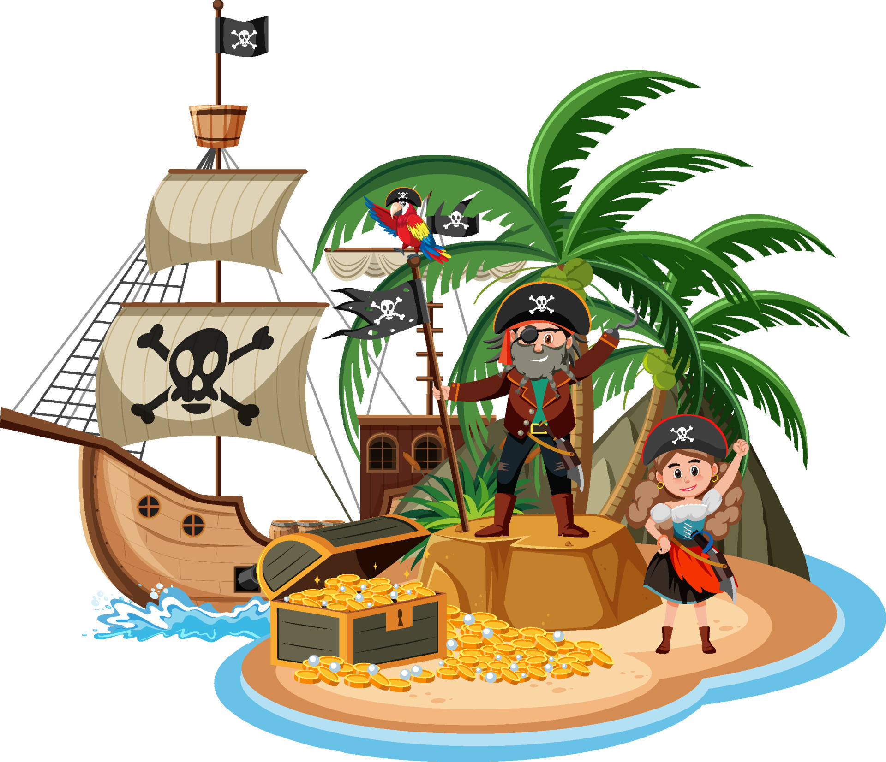
OUR TOPICS in KS1
Autumn Term | Spring 1 | Spring 2 | Summer Term
‘I’m an Alien get me out of here’ | Great Fire of London | Australia | Land Ahoy – Pirates

Slide 7
PE days for Opal:
Monday: indoor PE
Friday: outdoor PE
NOTE: Please make sure PE kits are in school everyday. Your child must have PE shoes which are different to the ones they wear to school.
PE days for Topaz:
Monday: Indoor PE
Thursday: Outdoor PE
Uniform – Shorts/Joggers, House Team coloured t-shirt, trainers/plimsolls, socks
No Earings

Slide 8
Reading
Reading records are also contact books so they need to be in school daily. We will check them daily so any comments or questions you have can be answered.
Reading little and often is the best way to keep children focused and to ensure they enjoy reading. We do not want it to become a chore or seen as extension of school.
Some useful techniques:
-shared reading; a page each
-shadow reading; you read a line, they read the same line back to you
-reading to your child
-one page a night rule

Slide 9
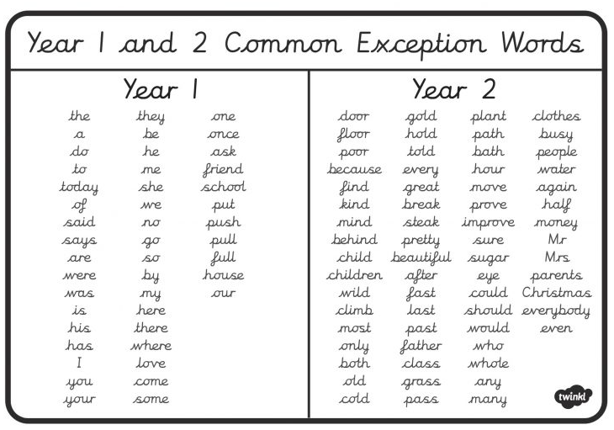
Common exception words
These are the words the government expect the children to be able to use and spell correctly in Year 1 and Year 2.

Slide 10
Home Learning… what is the point?
Provides children with time to extend and reflect on the learning they have covered
Allows for opportunities for the children to work collaboratively with family members to produce a piece of work
Prepares the children for the routine of having to produce homework further on in their school life
Spellings provide extra opportunities to practice the words they will be using in their writing

Slide 11
Year 1 | Year 2
Bug Club Occasional topic based homework (see grid) Targeted homework based on individual need Daily Reading | Bug Club / Spellings (Jan) Times Tables Rockstars Occasional topic based homework (see grid) Targeted homework based on individual need Daily Reading
Notes:
Year 2 will continue with bug club homework until January
Times table rockstars logins will be being sent home shortly

Slide 12
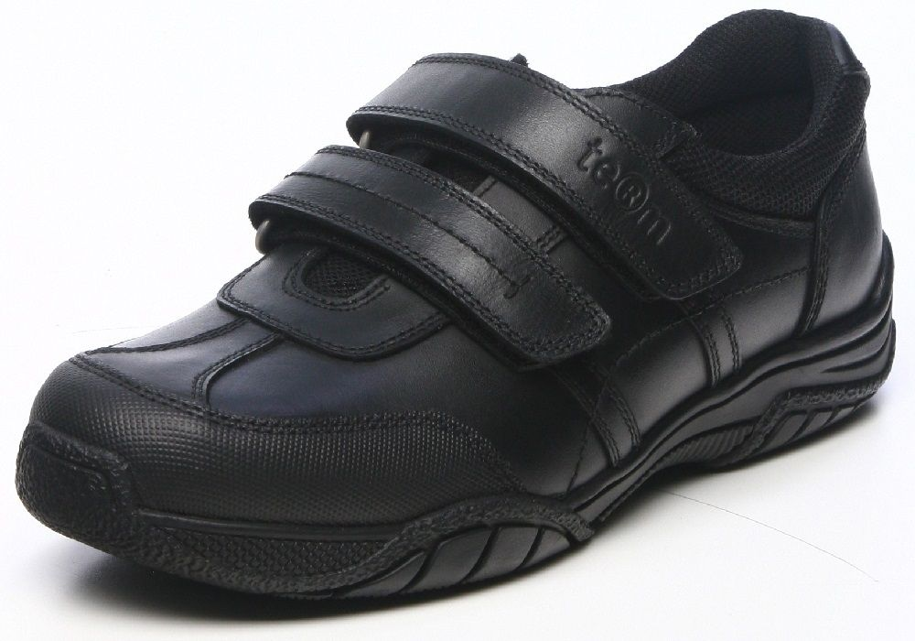
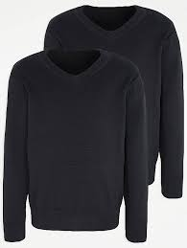
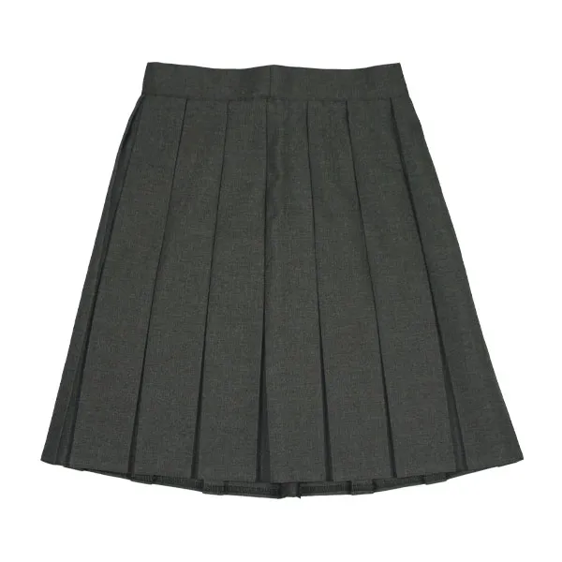
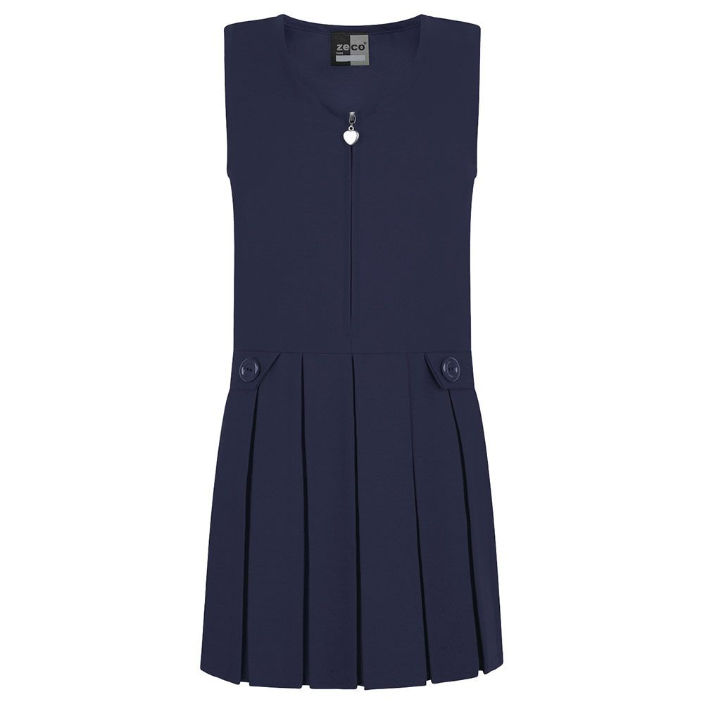
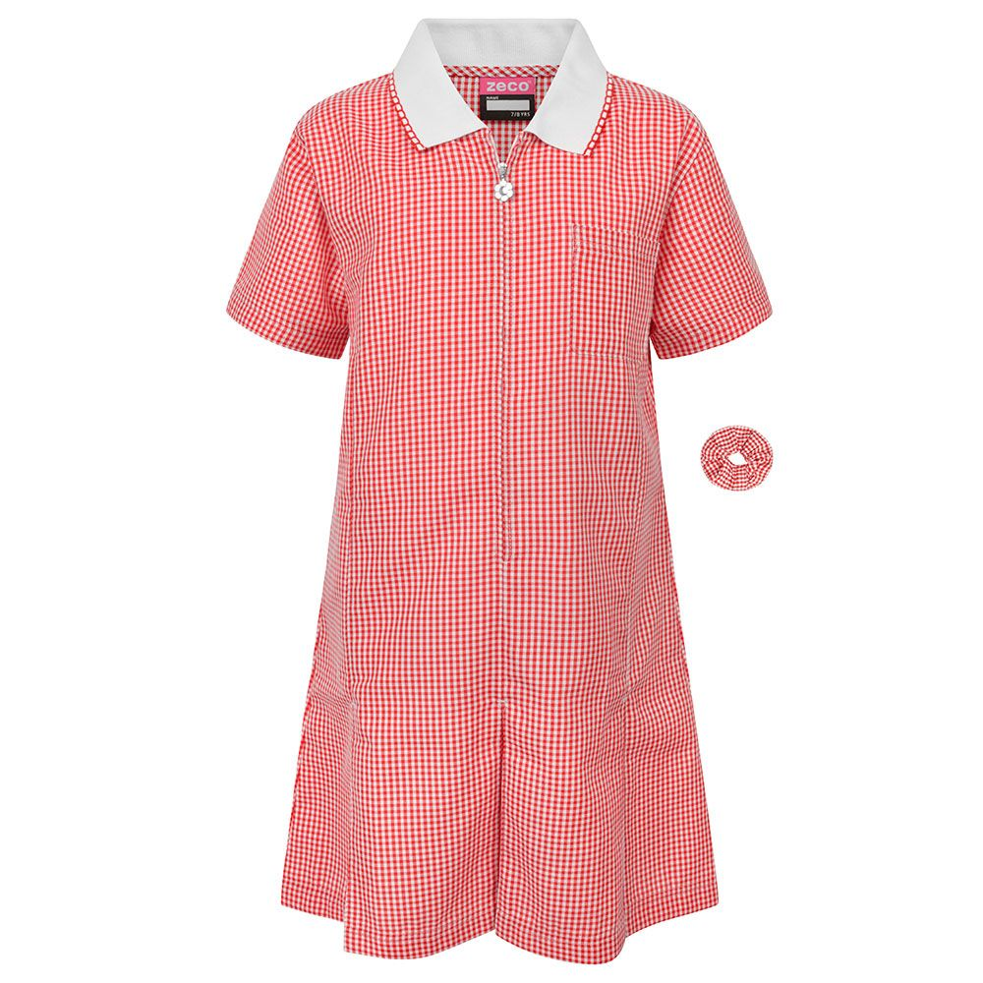
Uniform
Navy Jumper or Cardigan
White Polo Shirt
Navy/Grey trousers, short, skirts, pinafore dress,
Red and white check summer dress or culottes
White/grey/navy socks
Black shoes

Slide 13
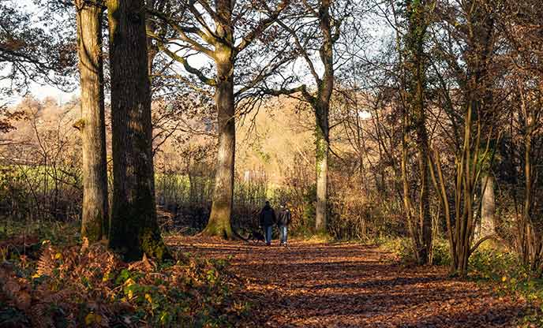
Ashdown Forest
Ashdown forest is an amazing day for your children to experience a fun day of learning offsite and outside, whatever the weather.
You will receive a list of dates for these visits.
Year 1 attend in the Summer Term
Year 2 will attend once per half term (A total of 6 within the year)
Notes:
Year 2 first visit – 6th October – More information to follow.
Parents take children there.

Slide 14
Any Questions?
Notes:
Overview of topics and homework grids being sent home Friday

