Slide 1

Welcome to Year 1 Meet the Teacher

Slide 2
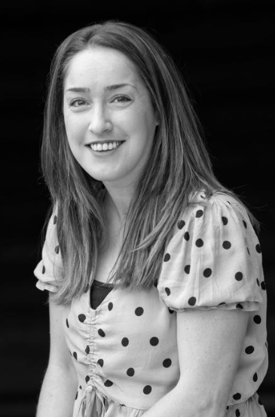
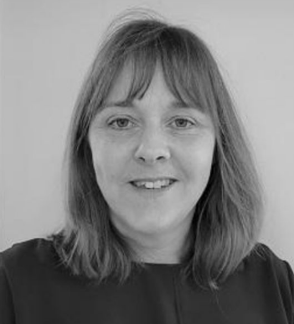
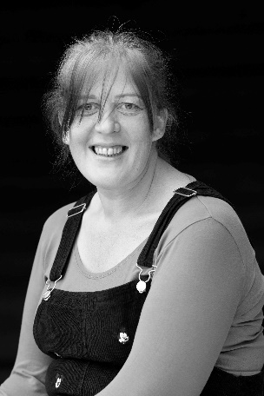
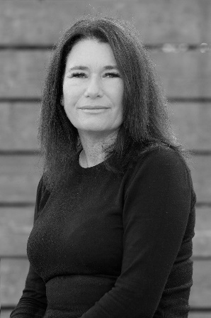
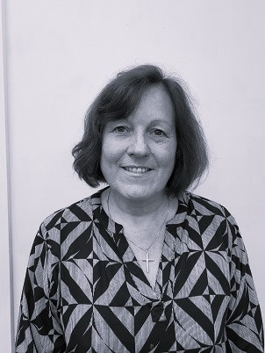
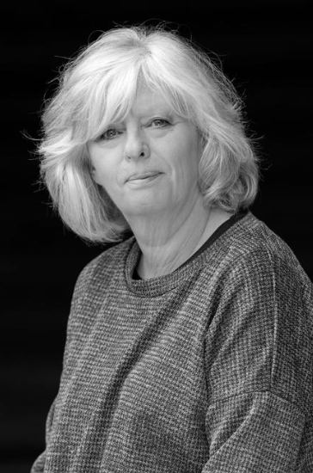
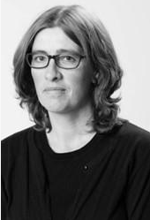
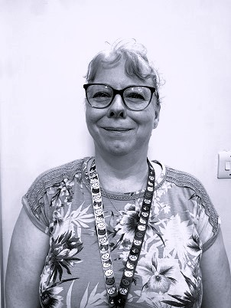
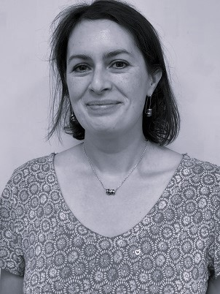
Adults we work with…
Miss Newns CT (Mon-Fri)
Mrs Bruce HLTA and cover (Mon – Fri am)
Ms Cross cover (Wed pm)
Mrs O’Riordan TA (M, T, T, F pm)
Mrs Lochhead ELSA (Wed pm)
Mrs Garrett
Mrs Pexton
Mrs Charman
Mrs Greenaway
Mrs Wood French (Tues am)

Slide 3
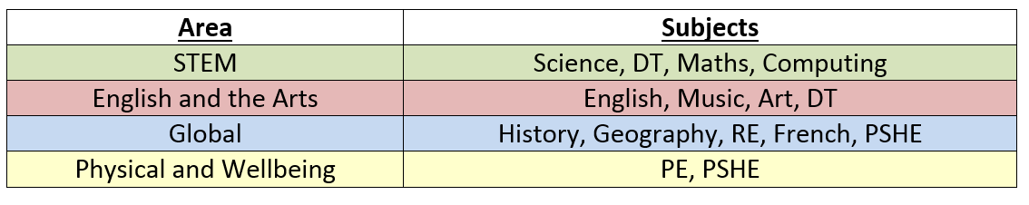
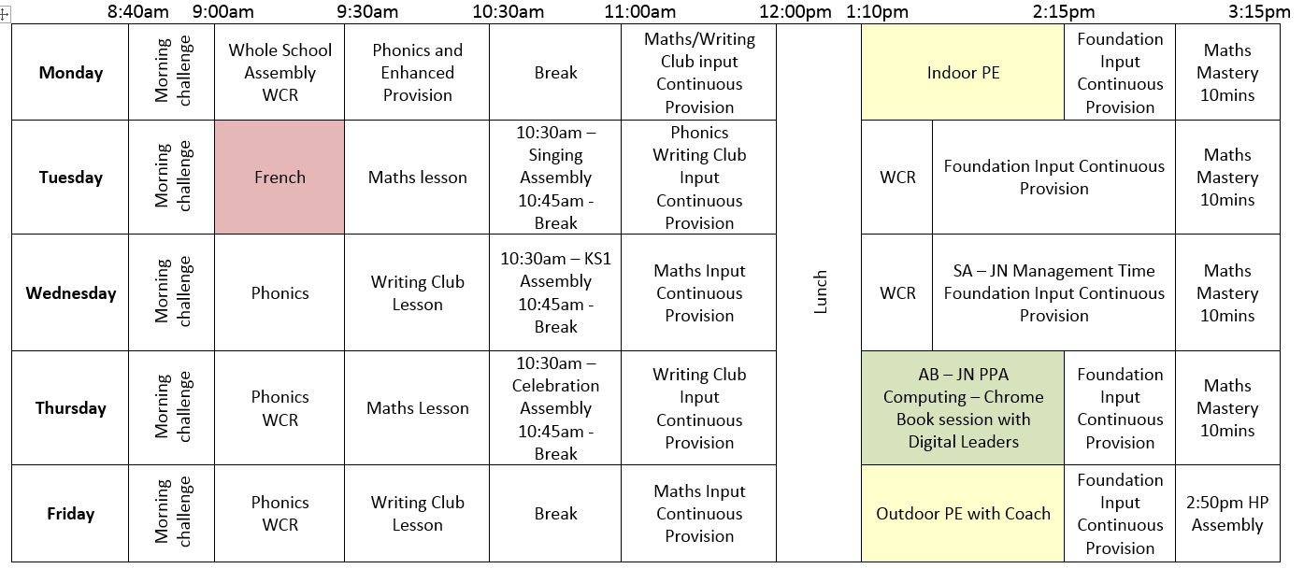
A typical day in Year 1:

Slide 4
Our Topics for the year:
Autumn 1 – How am I making History?
Autumn 2 – What is it like here?
Spring 1 – How have Toys changed?
Spring 2 – What is the weather like in the UK?
Summer 1 – How have explorers changed the world?
Summer 2 - What is it like to live in Shanghai?

Slide 5
PE Lessons
Monday - Indoor PE
Friday – Outdoor PE
Correct clothing – shorts, joggers, house team coloured t-shirt, trainers/plimsolls.
Socks.
No earrings.
Check things fit.
Leave PE kits in school.
Name everything please!

Slide 6
Reading Expectations…
Some useful techniques:
Shared reading - a page each.
Shadow reading - you read a line, they read the same line back to you.
Reading to your child.
One page a night rule.
Use the Bug Club library to add variety.
Reading record – checked daily and needed in school daily.
Adult to record in reading diary.
10 mins each day.
House points for reading.
Bug Club books AND online.
Adults will support changing their books with them, but try to build responsibility to know when it needs changing.
Assessments throughout the year.

Slide 7
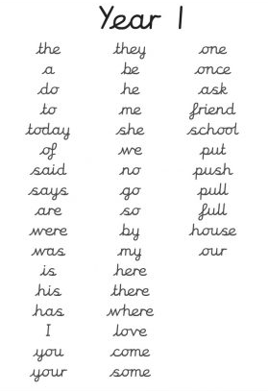
Spellings…TBA
Year 1/2 statutory word list (split between year groups).
Spelling rules.
Spelling test each week.
Continue using and applying phonics.
Edshed.
Spellings in home learning book.

Slide 8
Spelling Arrangements…
New spellings handed out on Friday in red spelling book.
Practiced throughout the week at home and school.
Tested on Thursday – BRING BOOK BACK!
Marked ready for new spellings to be handed out.

Slide 9
Home Learning…
Reading 5x week.
Spellings in red book.
Edshed spellings assignment - TBA.
Home learning grid – TBA.

Slide 10
Uniform…
Black/blue/grey trousers/skirts.
White polo/shirt.
Navy/blue cardigan or jumper.
Grey, navy, black or white socks.
Black school shoes.
Earrings – small studs but can be taped.
Long hair (shoulder length and below) must be tied back at all times, hair ties and headbands should be small and discreet in school colours only.
Children should not wear make up or nail polish in school.
Please ensure that ALL uniform and equipment is named.

Slide 11
Communication
Please email info@dormansland.surrey.sch.uk
We will then get in touch with you at the earliest opportunity.
We are always available on the playground at the end of the school day once the class has been dismissed.
For small non-urgent matters, notes could be put in the reading diaries.
Please also check messages on the class webpages, SCOPAY, Marvellous Me and school newsletters.

Slide 12
Others…
Parent readers.
Permission slips, medical and collection arrangements.
Day to day skills development (e.g. putting on coat, packing bags, tidying up etc)

Slide 13

Any Questions?

