Slide 1

Welcome to ‘Year 5 Meet the Teacher’

Slide 2
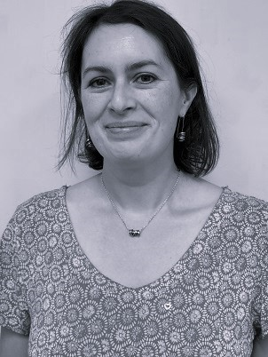
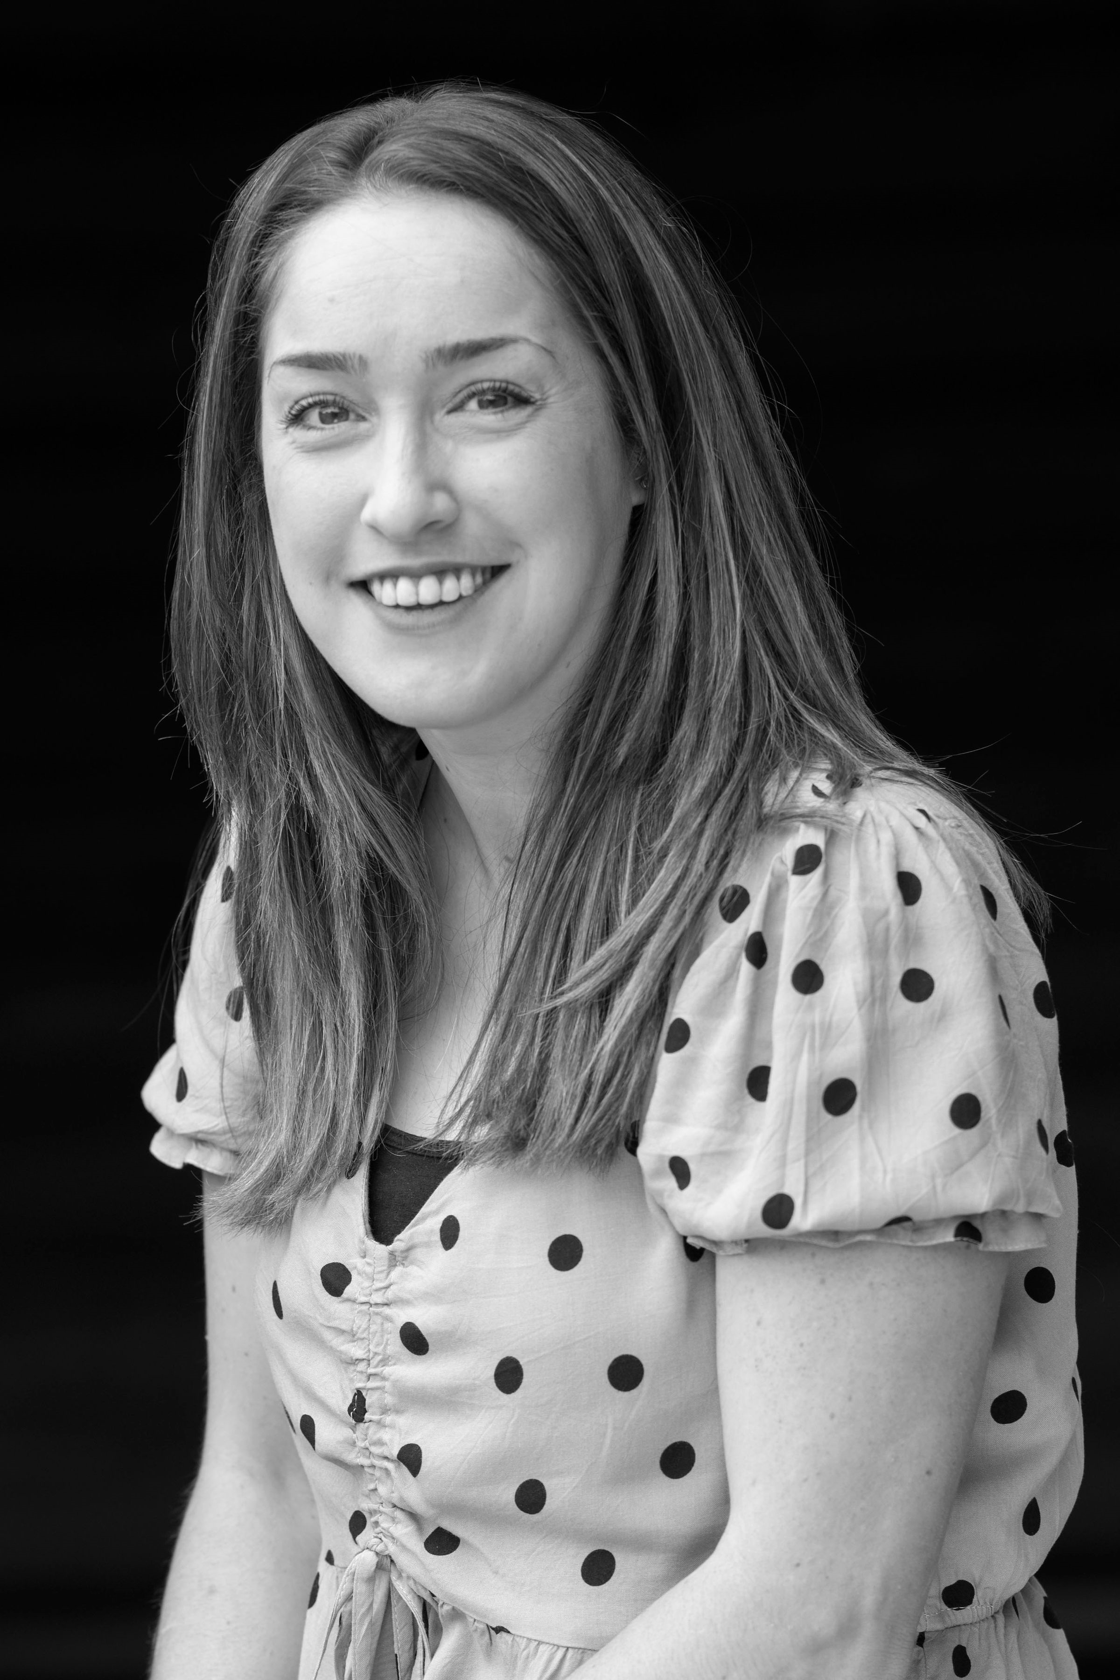
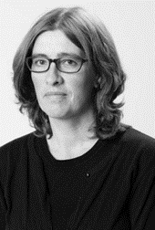
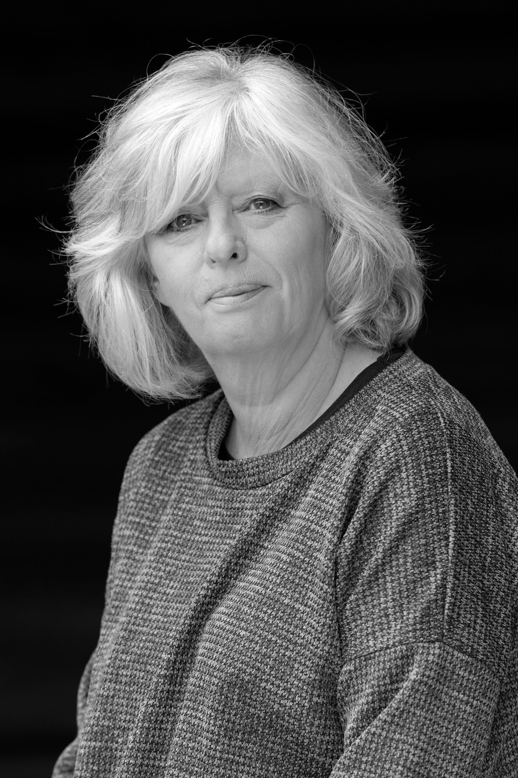
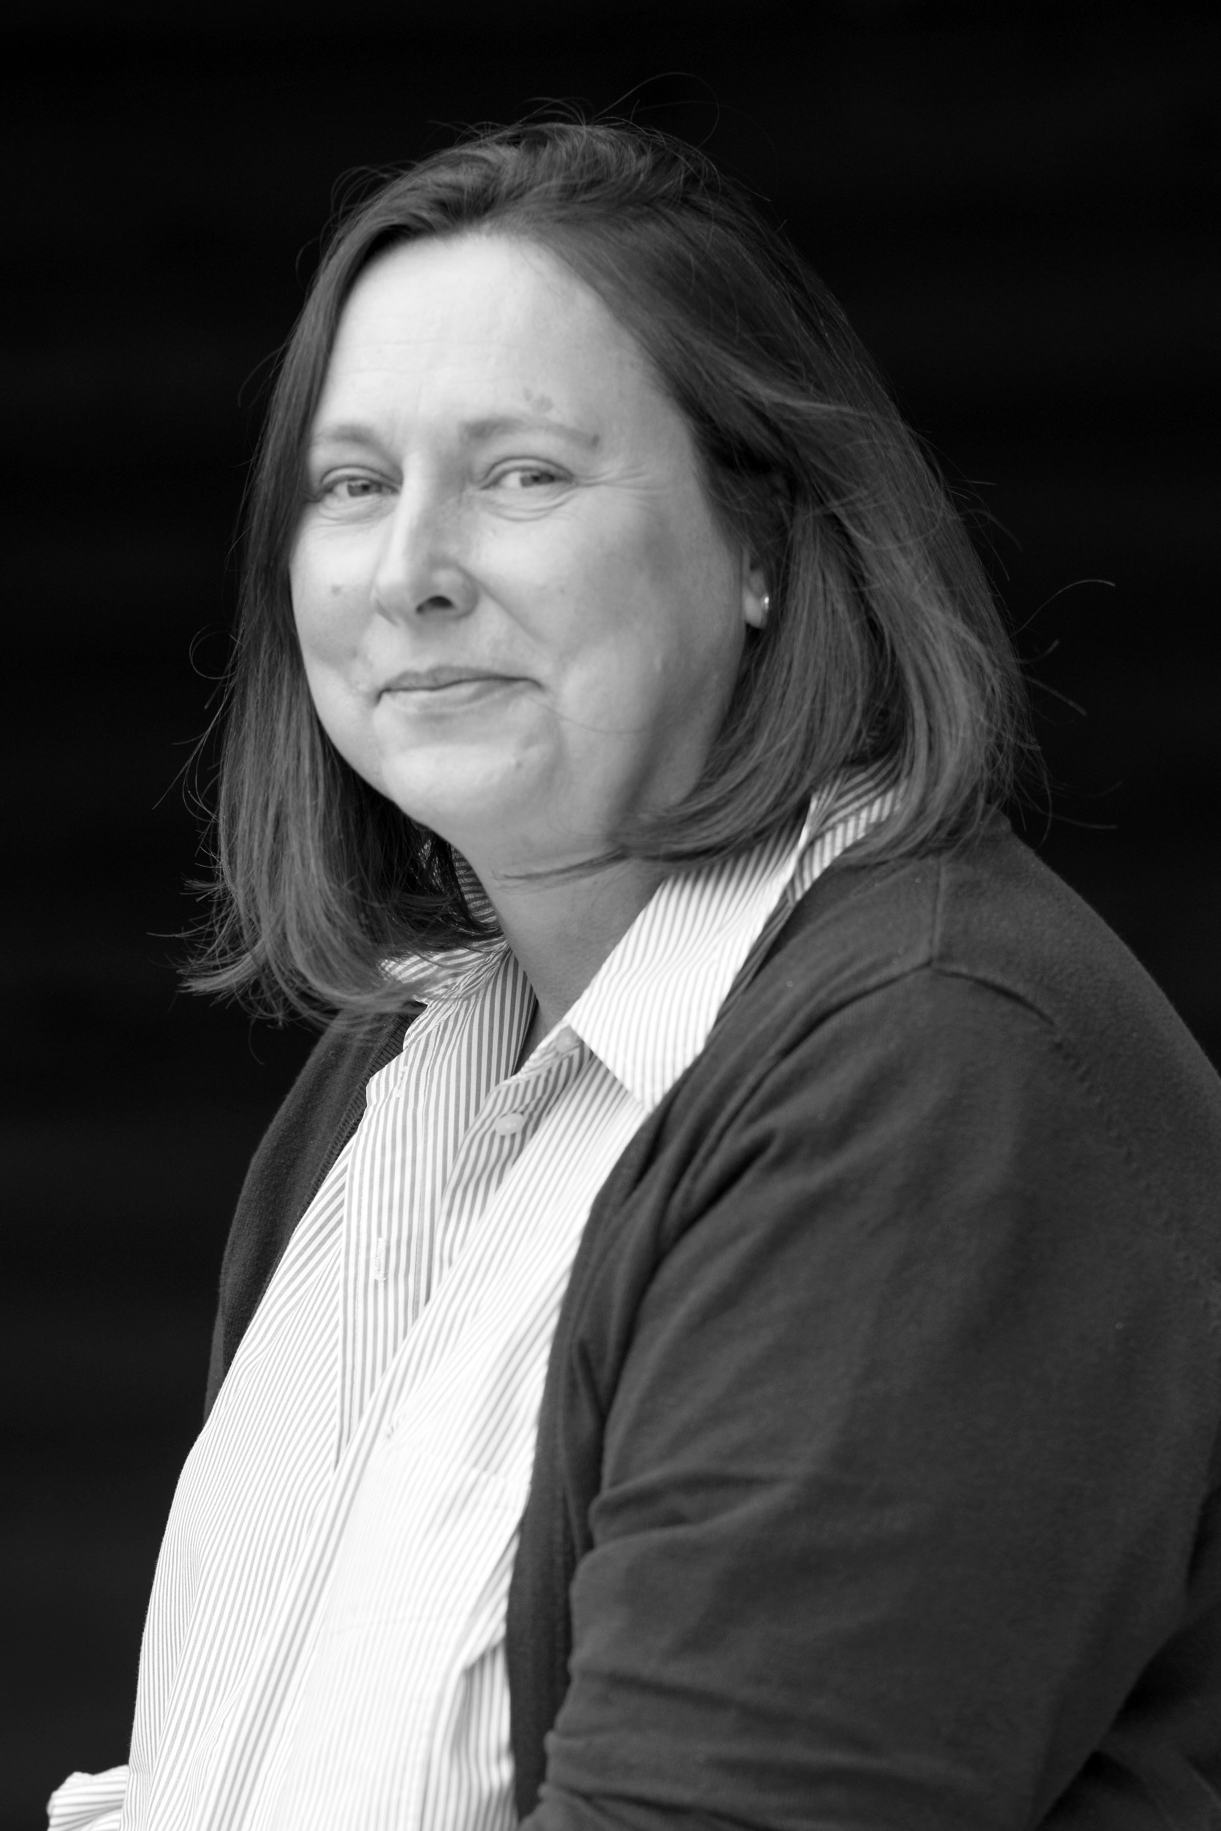
Adults working with us this year:

Slide 3
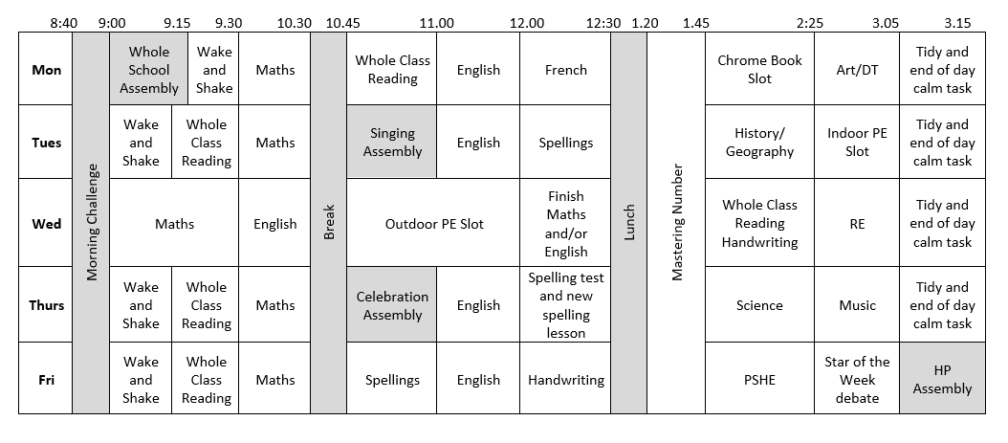
A typical week…

Slide 4
Our Autumn topics:
History
Geography
What was life like in Tudor England?
Fair ruler or tyrant – What was Henry VIII really like?
Why did Henry VIII have so many wives?
Why was Anne Boleyn executed?
What was a Royal Progress?
What was a Royal Progress like?
What can inventories tell us about life in Tudor times (part 1)?
What can inventories tell us about life in Tudor times (part 2)?
What is life like in the Alps?
Where are the Alps?
What is it like in the Alps?
Why do people visit the Alps?
What is there to do in our local area?
How are the Alps different from our local area?
What is life like in the Alps?
Trip: Hampton Court Palace

Slide 5

Trips
Hampton Court Palace.
Residential - Kent Life and Chatham Docks.
Ashdown Forest on 25th Sept and 13th Nov.

Slide 6

Behaviour
Class charter created by the children.
We are working hard to create a calm, quiet learning environment to show respect to our friends trying to learn.
We are reinforcing our school values of ‘Inspire, Nurture, Challenge, Curiosity, Respect, Resilience and Responsibility’.
We are working hard to minimise low level disruptions in class.
Referring to our Golden Thread.

Slide 7
PE Days
Tuesday = indoor
Wednesday = outdoor
Wear PE kit to school.
Correct clothing in line with school uniform policy – navy shorts/skorts, joggers, either house team coloured t-shirt or new navy PE short, trainers.
No earrings or tape to cover them up.
In the winter months, please ensure your child has a jumper for outdoor PE.

Slide 8
Uniform…
Black/blue/grey trousers/skirts.
White polo/shirt.
Navy/blue cardigan or jumper.
Grey, navy, black or white socks.
Black school shoes.
Earrings – small studs that must be removed by child for PE.
Long hair (shoulder length and below) must be tied back at all times, hair ties and headbands should be small and discreet in school colours only.
Children should not wear make up, nail polish or temporary tattoos in school.
Please ensure that ALL uniform and equipment is named.

Slide 9
Reading Expectations…
Reading record – checked regularly over the week.
Adult or child to record (e.g. independent reading).
10 mins each day.
House points for reading.
Bug Club books or online library.
Responsible for changing their book.
Assessments throughout the year.
Can read other books from home.
Mixture of structured reading but also reading for pleasure.

Slide 10
Spellings…
Year 4/5 statutory word list (split between year groups).
Spelling rules.
Spelling test each week.
Continue using and applying phonics.
Edshed sheet each week.
Spelling journal and spelling fluency books in school.

Slide 11
Spelling Arrangements…
New spellings handed out on Friday in yellow home learning book.
Practiced throughout the week at home and school.
Tested on Thursday – BRING BOOK BACK!
Marked ready for new spellings to be handed out on Friday.

Slide 12
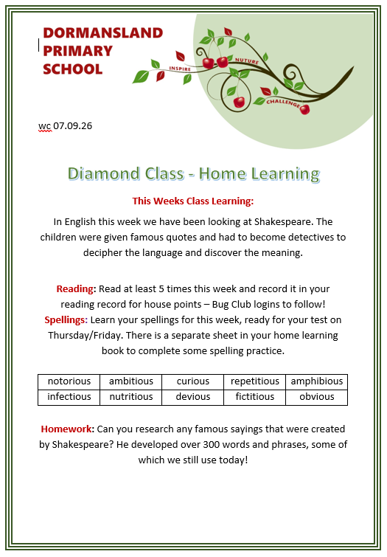
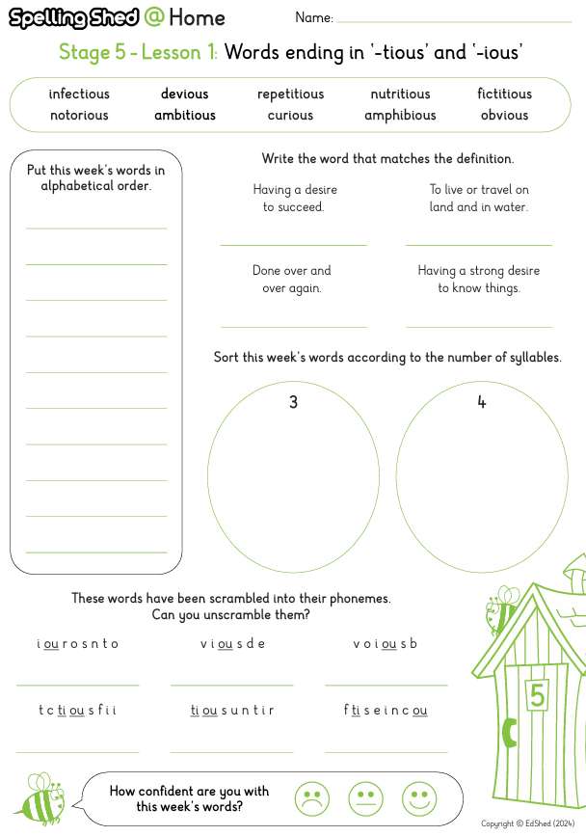
Home Learning…
Reading 5x week.
Eshed spelling sheet in yellow book.
Times Tables Rockstars.
Home learning task.
CGP book.

Slide 13
Communication
Please email info@dormansland.surrey.sch.uk with subject as FOA: ‘teacher name’
We will then get in touch with you at the earliest opportunity.
We are always available on the playground at the end of the school day once the class has been dismissed.
For small non-urgent matters, notes could be put in the reading diaries.
Please also check messages on emails, Arbor and school newsletters.

Slide 14
Any Questions?
Thank you for coming!

