Slide 1
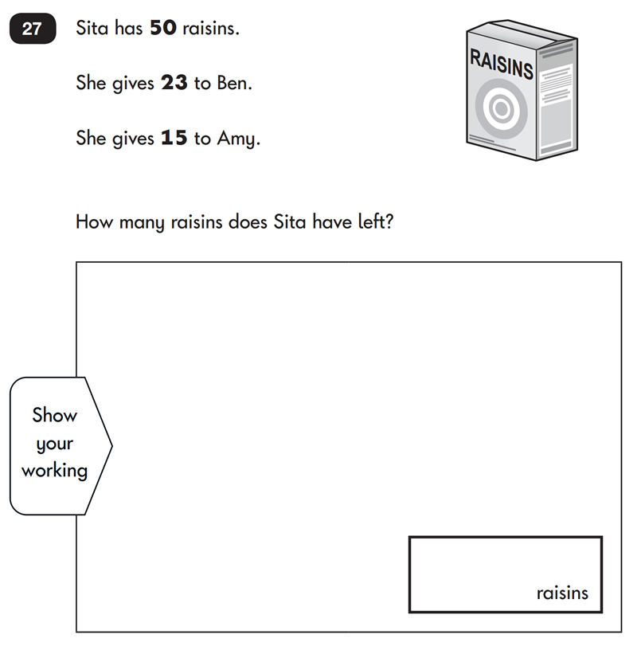

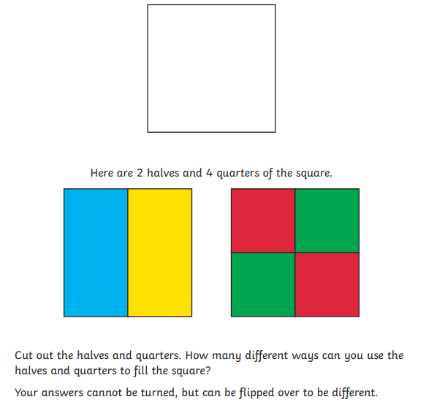
Good Morning Please have a go at this Maths problem while you wait.

Slide 2
Topaz class’ adults
Miss Moe : Class Teacher
Mrs O’Rioridan: Teaching Assistant (Monday- Friday mornings)
Teaching Assistants: (Mornings)- Mrs McGranaghan, Mrs Jovita, Miss Dee, Miss Larkin
(Afternoon) - Miss Floyd, Miss Simms, Miss Dee, Miss Larkin
Cover - Mrs Bruce (Monday afternoon)
Mrs Wood (every other Wednesday afternoon)

Slide 3
Communication
We aim to check Reading diaries daily so these are the best way of communicating with the teacher.
Or you can email the school office and this will get forwarded on.
Replies will then be forwarded back to you.
I will give updates and send messages via marvellous me or reading diaries – ensure you are set up to receive messages.

Slide 4
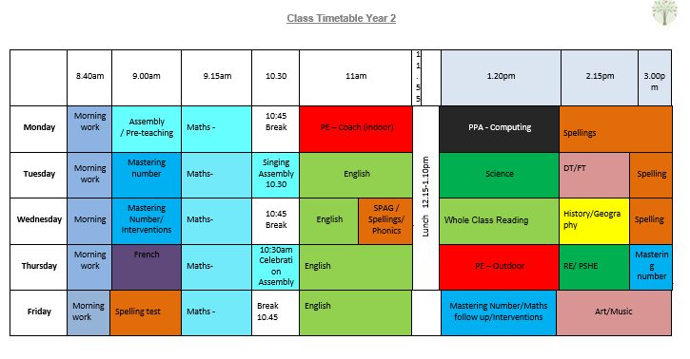

Slide 5
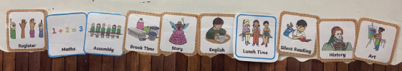
Visual timetable/ a typical day

Slide 6
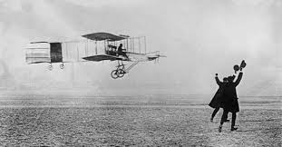
OUR TOPICS IN Topaz this year
Term 1: schools in the past
Term 2: Hot or cold places?
Term 3: How did we learn to fly?
Term 4: Why is our world wonderful?
Term 5: What is a monarch?
Term 6: What is it like to live by the coast?

Slide 7
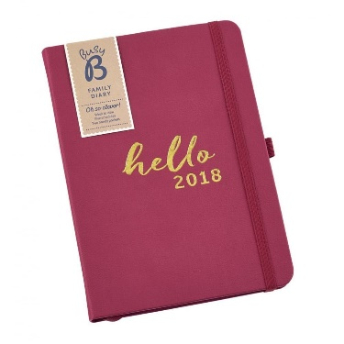
PE days for Topaz :
Monday Morning- indoor (with a coach)
Thursday Afternoon (outdoor)
NOTE: Please make sure PE kits are in school everyday. Your child must have PE shoes which are different to the ones they wear to school.

Slide 8
Show and Tell:
Wednesday/Friday Afternoons
Must be linked to learning or an achievement from a club.
Complete all spelling practice and home learning in the red book provided.

Slide 9
Reading
Reading records are also contact books so they need to be in school daily. We will check them daily so any comments or questions you have can be answered.
Reading little and often is the best way to keep children focused and to ensure they enjoy reading. We do not want it to become a chore or seen as extension of school.
Some useful techniques:
-shared reading; a page each
-shadow reading; you read a line, they read the same line back to you
-reading to your child
-one page a night rule
- use the bug club library to add variety

Slide 10
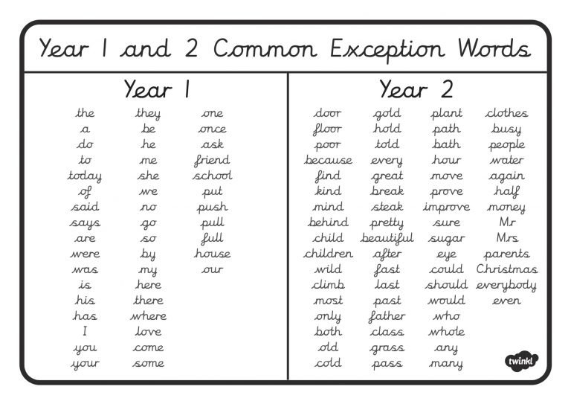
Common exception words
These are the words the government expect the children to be able to use and spell correctly in Year 1 and year 2

Slide 11
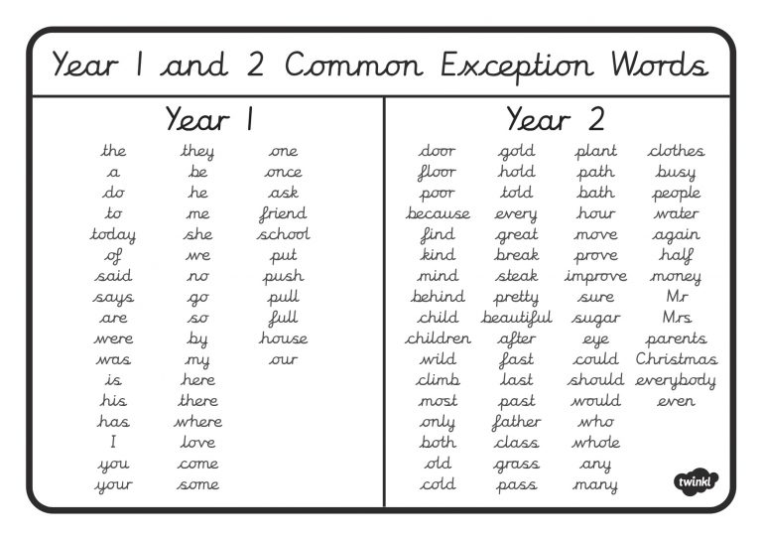

Slide 12
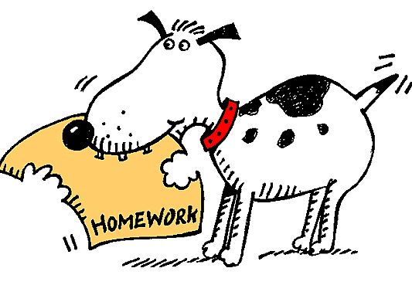
Home Learning
Provides children with time to extend and reflect on the learning they have covered
Allows for opportunities for the children to work collaboratively with family members to produce a piece of work
Prepares the children for the routine of having to produce homework further on in their school life
Spellings provide extra opportunities to practice the words they will be using in their writing
Home learning grids and curriculum overviews
will be handed out at the end of next week

Slide 13

Home learning
Bug club reading and phonics activities - specific to your child’s reading stage
Spelling shed- log in details will be given out. Year 1 will start spellings after Christmas and you will receive log in details then.
Times table rock stars (Year 2)- log in details will be given out in the Autumn term
Daily reading
Termly topic based home learning
Targeted homework based on individual needs

Slide 14
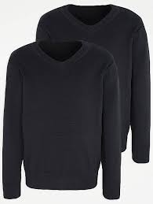
Uniform
Navy or grey trousers, skirt, pinafore or shorts
Navy sweatshirt (school logo items can be purchased from the school office)
White polo shirt (school logo items can be purchased from the school office)
Red check summer dress or culottes
Grey, navy or white socks
Black school shoes (sports trainers or boots are not acceptable footwear)
Jewellery must not be worn for reasons of safety. If your child has pierced ears only the smallest of studs should be worn to school but these must be removed by the child for P.E.
Long hair (shoulder length and below) must be tied back at all times, for both boys and girls. Hair ties and headbands should be small and discreet in school colours only. Please note that extreme hairstyles are not appropriate for school and make-up and nail varnish should not be worn.

Slide 15

Any Questions?

