Slide 1

Welcome to Year 3
(Amethyst Class)
Meet the Teacher

Slide 2
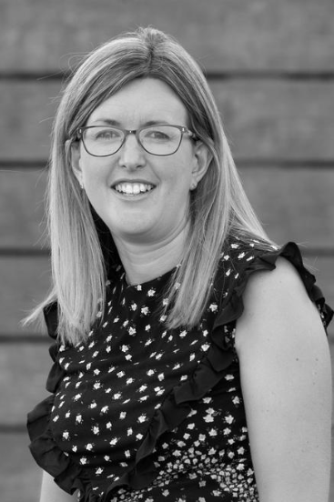
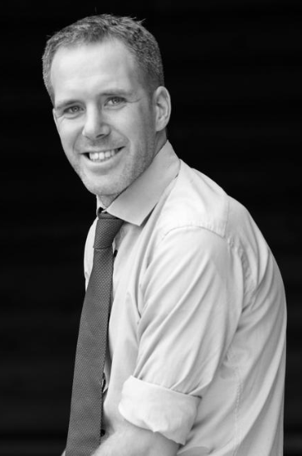
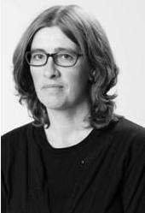
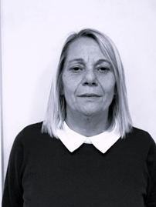
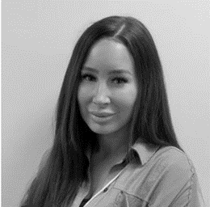
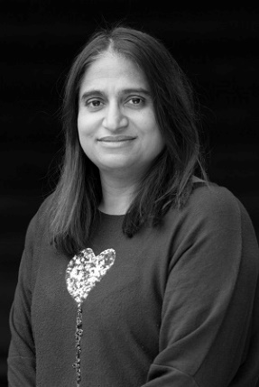
Adults we work with…
Year 3
Mrs Pollard CT: (Tues-Fri)
Mr Cook CT: (Mon)
Mrs Wood TA: (Mon-Fri)
Mrs Larkin TA: (Mon & Tues)
Miss D TA: (Wed - Fri)
Ms Degia TA: (Tues)

Slide 3
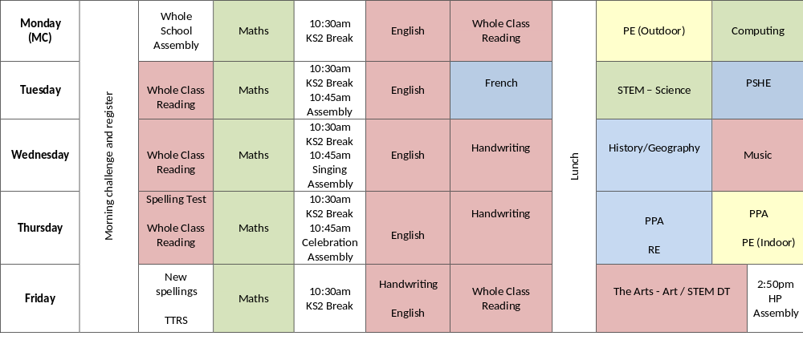
A typical day in Year 3:
8:40am 9:00am 10:30am 11:00am 12:00pm 12:30pm 1:20pm 2:15pm 3.15pm

Slide 4
Year 3 Learning - Autumn Term:
History – Stone Age
Geography - Volcanoes
Life in the Stone Age.
Skara Brae and Stone Henge.
Who was the Amesbury Archer?
Iron Age and Bronze Age.
Artefacts.
Hunter gathering.
How the earth is constructed.
Mountains.
Volcano formation.
Volcanic eruptions.
Earthquakes.
Types of rocks.

Slide 5
PE Lessons
Year 3 PE days = Mondays (outdoors) and Thursdays (indoors)
Wear PE kit to school.
Correct clothing in line with school uniform policy – shorts/skorts, joggers, house team coloured t-shirt, trainers.
No earrings or tape to cover them up.

Slide 6
Reading Expectations…
Reading record – checked regularly over the week.
Adult or child to record (e.g. independent reading).
10 mins each day.
Housepoints for reading.
Bug Club.
Responsible for changing their book.
Assessments throughout the year.

Slide 7
Spellings…
Year ¾ statutory word list (split between year groups).
Continue using and applying phonics.
Spelling rules.
Practised throughout the week at home and at school.
Spelling test each week (Thurs), new spellings come home every Friday.
Spelling fluency books in school.

Slide 8
Home Learning…
Weekly home learning letter in yellow home learning book. Will include short description of learning in class that week and a homework task linked to this. (Varied topic each week)
Daily reading.
Spellings in home learning book alongside a spelling activity (bring back each Thursday).
Times Tables Rockstars. (Little and often)

Slide 9
Uniform…
Black/blue/grey trousers/skirts.
White polo/shirt.
Navy/blue cardigan or jumper.
Grey, navy, black or white socks.
Black school shoes.
Earrings – small studs that must be removed by child for PE.
Long hair (shoulder length and below) must be tied back at all times, hair ties and headbands should be small and discreet in school colours only.
Children should not wear make up, nail polish or temporary tattoos in school.
Please ensure that ALL uniform and equipment is named.

Slide 10
Communication
Please email info@dormansland.surrey.sch.uk with subject as FOA: ‘teacher name’
We will then get in touch with you at the earliest opportunity.
We are always available on the playground at the end of the school day once the class has been dismissed.
For small non-urgent matters, notes could be put in the reading diaries.
Please also check messages on the class webpages, SCOPAY, Marvellous Me and school newsletters.

Slide 11
Others…
Parent readers.
Pieces of fruit or plain breadsticks for snack.
Equipment.
Permission slips, medical and collection arrangements.

Slide 12

Any Questions?

