Slide 1

Welcome to Ruby Class
Meet the Teacher

Slide 2
Settling in well...
To become familiar with daily routines.
Begin building positive relationships with adults and peers.
To develop confidence when exploring the learning environment.

Slide 3
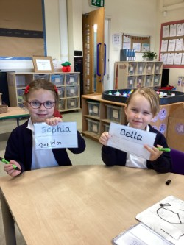
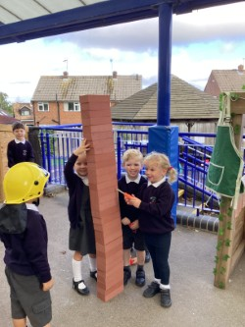
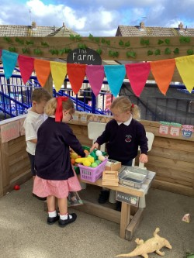
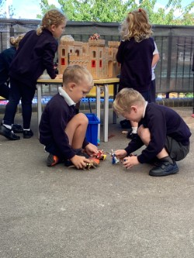
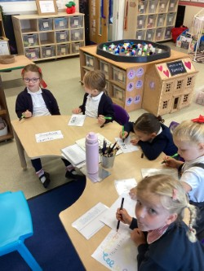
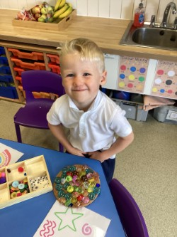
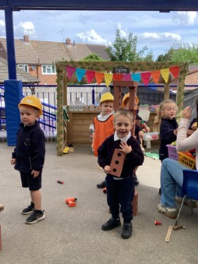
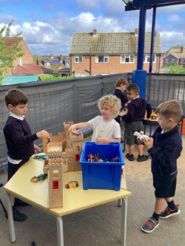
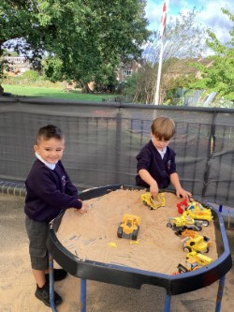
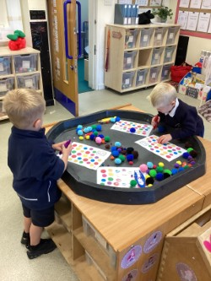
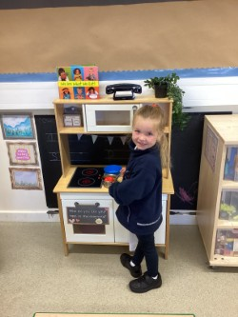
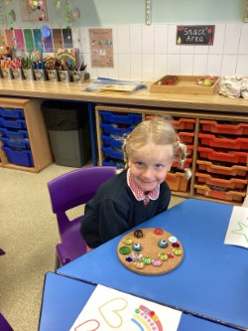
Settling in…

Slide 4
Communication
Newsletter
Email
School website

Slide 5
Class Contact
Please ensure that you have a class representative.
We understand that WhatsApp can be a useful tool for communication. However, please only use the class WhatsApp group for information sharing.
Concerns, problems and question please email the office directly by email or telephone.
I am normally available at the end of the school day, once the class has been dismissed.
Small messages and reminders can also be communicated through the yellow reading diaries.

Slide 6
RUBY TEAM:
Miss Carter
Ms Cross (Every morning)
Mrs Ford (Every afternoon and Fri morning)
Mrs Larkin (Mon-Tue afternoon)
Miss Demee (Wed-Fri afternoon)

Slide 7
Our targets this term in Ruby Class:
Separates from grown-ups with increasing confidence.
Developing a ‘have a go’ attitude when putting on coat, using zips, buttons and cutting our food at the lunchtime.
Responds to own name and follows simple instructions.
Interacting positively with adults and peers.
Joins in with whole-class routines and carpet sessions
Feeling happy, safe and settled in our new classroom environment.

Slide 8
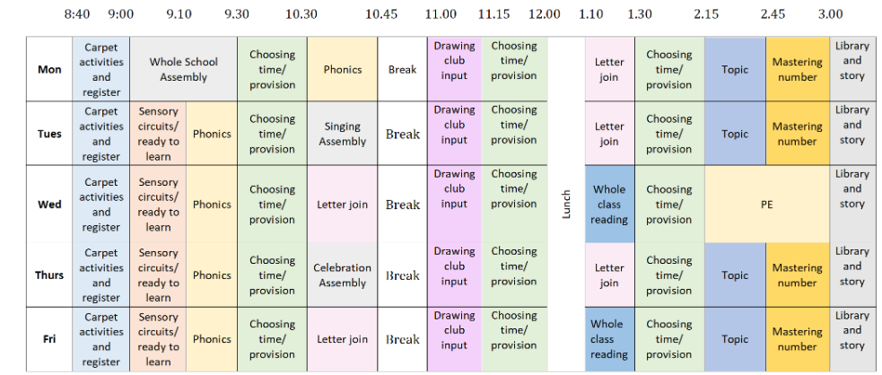
Our class timetable:

Slide 9
Reading and Phonics
We use bug club for our reading and phonics teaching.
Bug club logins are on the inside cover of the reading diaries.
I will be setting phonic activities and colour banded books.
Once onto reading books, your child will bring home a book to share with you.
Please update the reading diary with any reading you do, this can also include books from home.
We do not change books daily, repetition is key!

Slide 10
Reading ready
Playing ‘I spy’ games- in the car or on walks to develop listening and sound awareness.
Talking about what you can see in pictures and books to build vocabulary and develop language.
Sorting letter and the sound they make.
Encouraging children to read stories with you and predicating what might happen next.
Listening to audio books.
Most importantly this should be fun and relaxed ☺

Slide 11
Maths ready
Looking for shapes in the natural world.
Counting together (steps, toys cars and objects).
Talk about size and amounts (bigger and smaller, longer and shorter, full and empty.)
Playing simple games for example, dice games, board games, puzzles and matching games.

Slide 12
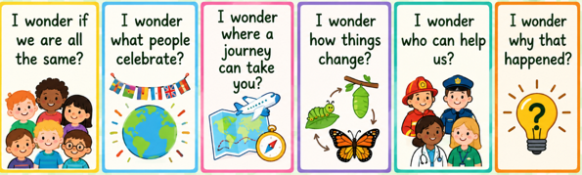
Our Topics
Current Topic

Slide 13
Reminders
Please make sure all items of clothing are labelled.
Red book bag only.
Reading diary should be kept in the red book bag.
Water only in water bottles.
Our PE day will be on Wednesdays (NO earrings).
Thank you! Any questions?

