Slide 1



Welcome to the Year 4 ‘Meet the teacher’

Slide 2
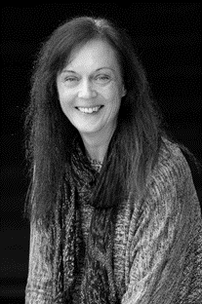
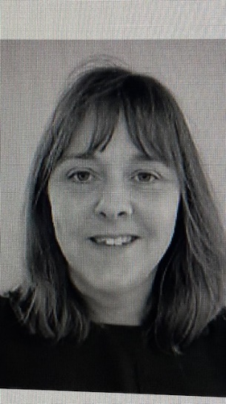
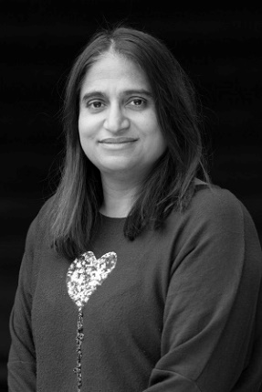
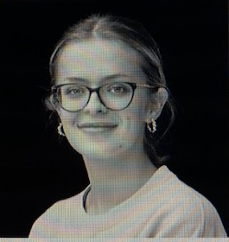
Adults we work with…
Year 4
Miss Wells CT
Mrs Bruce TA (Mon-Fri am)
Ms Degia TA (Mon, Wed, Thurs, Fri pm)
Miss Floyd (Mon, Wed am)
Mrs Higginson (Fri am)

Slide 3

Our School Vision
When they leave us, children will be confident, resilient learners, with a positive self-image, who are ready for the challenges, opportunities and social responsibilities of a continually changing world.

Slide 4
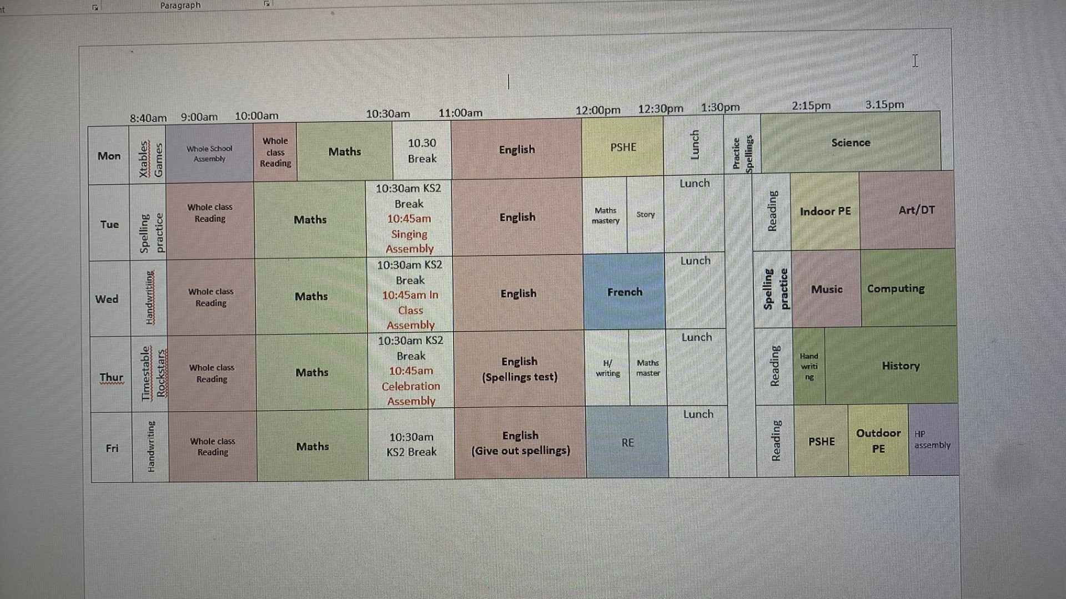
A typical day in Year 4:

Slide 5
Our Topics this year include..
Autumn Term – How children’s lives have changed in History and the importance of rainforests in Geography. We are also learning to play the Recorder! We also plan to visit Kew Gardens.
Spring Term – the History of invaders and settlers in Britain and looking at where our food comes from. Science is looking at electricity and energy.
Summer Term - All about the Vikings and how our rivers are used. We will also be trying out edible gardens as well as a French Café.

Slide 6
Uniform…
Black/blue/grey trousers/skirts.
White polo/shirt.
Navy/blue cardigan or jumper.
Grey, navy, black or white socks.
Black school shoes.
Earrings – small studs that must be removed by child for PE or taped.
Long hair (shoulder length and below) must be tied back at all times, hair ties and headbands should be small and discreet in school colours only.
Children should not wear make up or nail polish in school.
Please ensure that ALL uniform and equipment is named.

Slide 7
Behaviour Policy
We are working hard to minimise low level disruptions in class.
Towards this goal, we use our ‘Golden Thread’,
Stop
Think
Am I making the right choice?
With that in mind, if the children have been on the ? 3 times in a week, we will be contacting you.

Slide 8
PE Lessons
Year 4 PE days = Tuesday (indoor) & Friday (outdoor).
Correct clothing – shorts, joggers, school t-shirt, socks and trainers.
No earrings if possible on PE days – otherwise taped up.

Slide 9
Reading Expectations…
Reading record – checked regularly over the week.
Adult or child to record (e.g. independent reading).
10 mins each day.
Housepoints for reading.
Bug Club. Read a book from their bug club level at least once per week.
Responsible for changing their book.
Assessments throughout the year.

Slide 10
Spellings…
Year 3 and 4 statutory word list (split between year groups).
Spelling rules.
Spelling test each Thursday
Continue using and applying phonics.
Spelling journal for practice and spelling fluency books for the practice of set spellings in school.

Slide 11
Weekly Spelling Arrangements…
New spellings handed out on Friday in red
spelling book.
Practised throughout the week at home and school.
Tested on Thursday – BOOKS NEED TO BE BACK!
Marked ready for new spellings to be handed out.

Slide 12
Home Learning…
Reading 5 x week.
Spellings in homework book.
Times Tables Rockstars – little and often.
Weekly homework task –see homework books.

Slide 13
Extra notes…
Parent readers.
Pieces of fruit or plain breadsticks for snack.
Equipment - no novelty items please.
Permission slips, medical and collection arrangements.

Slide 14
Communication
Please email info@dormansland.surrey.sch.uk
We will then get in touch with you at the earliest opportunity.
We are always available on the playground at the end of the school day once the class has been dismissed (except on a Monday PPA).
For small non-urgent matters, notes could be put in the reading diaries.
Please also keep an eye out for messages via SCOPAY and school newsletters.

Slide 15

Any Questions?

Slide 17
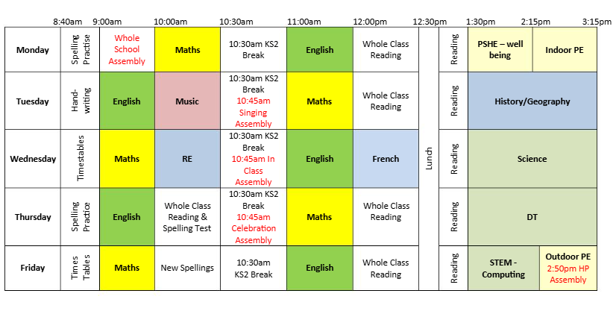
A typical day in Year 4:

