Slide 1

Welcome to Year 4
Meet the Teacher

Slide 2
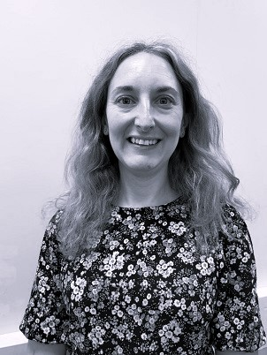
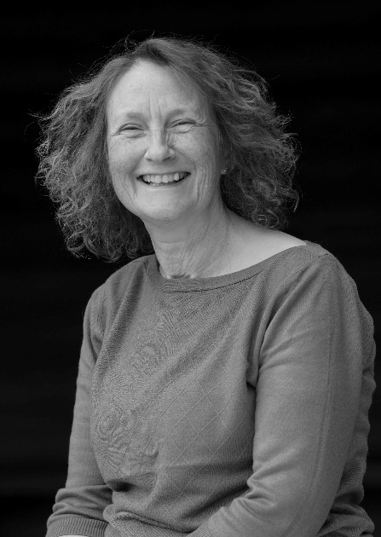

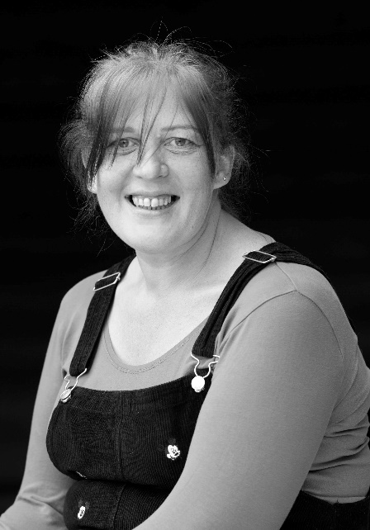

Adults we work with…
Year 4
Miss Burton CT (Wed-Fri)
Mrs Wadey CT (Mon-Tues)
Ms Degia TA (Mon-Fri)
Ms Cross TA (PPA cover)
Mrs Lochhead (Pastoral)

Slide 3
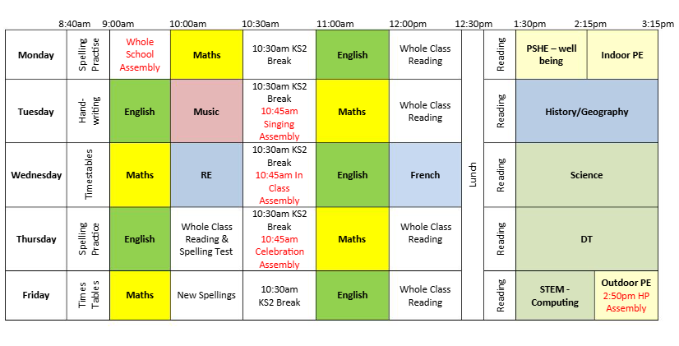
A typical day in Year 4:

Slide 4
Our Topics this year include..
Autumn Term – How children’s lives have changed in History and the importance of rainforests in Geography. We ae also learning to play the Recorder! 5th November is our Kew Gardens visit.
Spring Term – the History of invaders and settlers in Britain and looking at where our food comes from. Science is looking at electricity and energy.
Summer Term - All about the Vikings and how our Rivers are used. We will also be trying out edible gardens as well as a French Café.

Slide 5
PE Lessons
Year 4 PE days = Monday & Friday
Correct clothing – shorts, joggers, house team coloured t-shirt, socks and trainers.
No earrings if possible on PE days – otherwise taped up.

Slide 6
Reading Expectations…
Reading record – checked regularly over the week.
Adult or child to record (e.g. independent reading).
10 mins each day.
Housepoints for reading.
Bug Club. Read a book from their bug club level at least once per week.
Responsible for changing their book.
Assessments throughout the year.

Slide 7
Spellings…
Year 3 and 4 statutory word list (split between year groups).
Spelling rules.
Spelling test each Thursday
Continue using and applying phonics.
Edshed – in Spellingshed available from Thurs….for following week. Please let as know asap if it’s not working.
Spelling journal for practice and spelling fluency books for the practice of set spellings in school.

Slide 8
Weekly Spelling Arrangements…
New spellings handed out on Friday in red spelling book.
Practised throughout the week at home and school.
Tested on Thursday – BOOKS NEED TO BE BACK!
Marked ready for new spellings to be handed out.

Slide 9
Home Learning…
Reading 5 x week.
Spellings in red book.
Edshed spellings assignment.
Times Tables Rockstars – little and often.
Home learning grid.

Slide 10
Uniform…
Black/blue/grey trousers/skirts.
White polo/shirt.
Navy/blue cardigan or jumper.
Grey, navy, black or white socks.
Black school shoes.
Earrings – small studs that must be removed by child for PE.
Long hair (shoulder length and below) must be tied back at all times, hair ties and headbands should be small and discreet in school colours only.
Children should not wear make up or nail polish in school.
Please ensure that ALL uniform and equipment is named.

Slide 11
Communication
Please email info@dormansland.surrey.sch.uk
We will then get in touch with you at the earliest opportunity.
We are always available on the playground at the end of the school day once the class has been dismissed.
For small non-urgent matters, notes could be put in the reading diaries.
Please also check messages on the class webpages, SCOPAY, Marvellous Me and school newsletters.

Slide 12
Extra notes…
Parent readers.
Pieces of fruit or plain breadsticks for snack.
Equipment - no novelty items please.
Permission slips, medical and collection arrangements.

Slide 13

Any Questions?

