Slide 1

Good Morning
Welcome to Year 1 Meet the Teacher

Slide 2
Adults in Opal Class
Mrs. Wadey: Class Teacher (Monday and Tuesday)
Miss Burton: Class Teacher (Wednesday, Thursday and Friday)
Mrs. Luque: H.L.Teaching Assistant (Monday- Friday mornings)
Mrs. Franklin: Teaching Assistant (Monday, Tuesday and Wednesday mornings)
Mrs. Larkin ( All day Thursday and Friday)
Mrs. Pexton :Teaching Assistant (Monday, Tuesday, Wednesday and Friday afternoons)
Mrs. Rees (Monday, Tuesday and Wednesday afternoons)
Ms Cross: H.L. Teaching Assistant for class cover
Mrs. O’Riordan: Teaching Assistant (Thursday afternoon)

Slide 3
Communication
Reading diaries are checked daily so this is the best way of communicating with the teacher or you can email the office, this will get forwarded on and we will then get in touch with you at the earliest opportunity.
info@dormansland.surrey.sch.uk
We are always available on the playground at the end of the school day once the class has been dismissed.

Slide 4
A typical day in Opal Class
AM
Early learning and register ​
​
Introduce activities for the day ​
​Phonics
English whole class input ​ or
​Maths whole class input
Assembly ​
​
Break time ​
Short English whole class input ​ or
​Maths whole class input
​
​​Exploring activities
PM Lunch​
​
Register ​
​
Foundation subjects (e.g. Art, History, PE
​
Exploring activities
​
Story time ​
​
Home time ​
​

Slide 5
OUR TOPICS IN Opal this year
Term 1 : Houses and homes – including castles and what is it like where I live in Geography
Term 2: Toys - including history of toys and making puppets in DT
Term 3: Explorers – including how they have changed the world and life in Shanghai in Geography

Slide 6
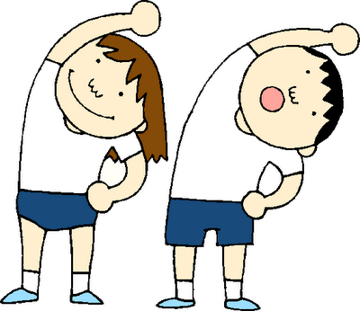
PE days for Opal Class
Monday: indoor PE
Friday: outdoor PE
NOTE: Please make sure PE kits are in school everyday and items are named. Your child must have PE shoes which are different to the ones they wear to school.

Slide 7

Reading
Reading records are also contact books so they need to be in school daily. We will check them daily so any comments or questions you have can be answered.
Reading little and often is the best way to keep children focused and to ensure they enjoy reading. We do not want it to become a chore or seen as an extension of school.
Some useful techniques:
- shared reading; a page each
- shadow reading; you read a line, they read the same line back to you
- reading to your child
- one page a night rule
- use the bug club library to add variety

Slide 8


Common exception words
These are the words the government expect the children to be able to use and spell correctly in Year 1.

Slide 9

Home Learning… what is the point?
Provides children with time to extend and reflect on the learning they have covered
Allows for opportunities for the children to work collaboratively with family members to produce a piece of work
Prepares the children for the routine of having to produce homework further on in their school life
Spellings provide extra opportunities to practice the words they will be using in their writing

Slide 10

Home learning
Bug club reading and phonics activities - specific to your child’s reading stage
Year 1 start spellings after Christmas.
Daily reading
Homework activity (given out Friday for the following Thursday)

Slide 11
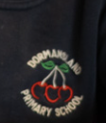
Uniform
Navy or grey trousers, skirt, pinafore or shorts
Navy sweatshirt (school logo items can be purchased from the school office)
White polo shirt (school logo items can be purchased from the school office)
Red check summer dress or culottes
Grey, navy or white socks
Black school shoes (sports trainers or boots are not acceptable footwear)
Jewellery must not be worn for reasons of safety. If your child has pierced ears only the smallest of studs should be worn to school but these must be removed by the child for P.E.
Long hair (shoulder length and below) must be tied back at all times, for both boys and girls. Hair ties and headbands should be small and discreet in school colours only.
Please note that extreme hairstyles are not appropriate for school and make-up and nail varnish should not be worn.

Slide 12

Any Questions?

