Slide 1

Welcome to Year 3
(Amethyst Class)
Meet the Teacher

Slide 2
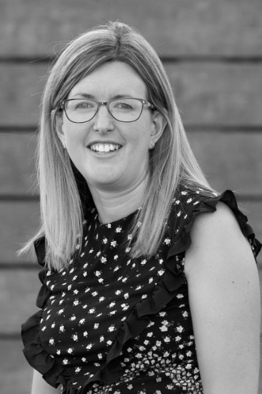
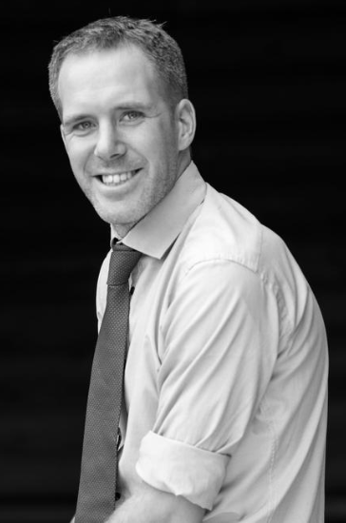
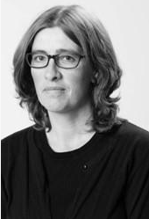
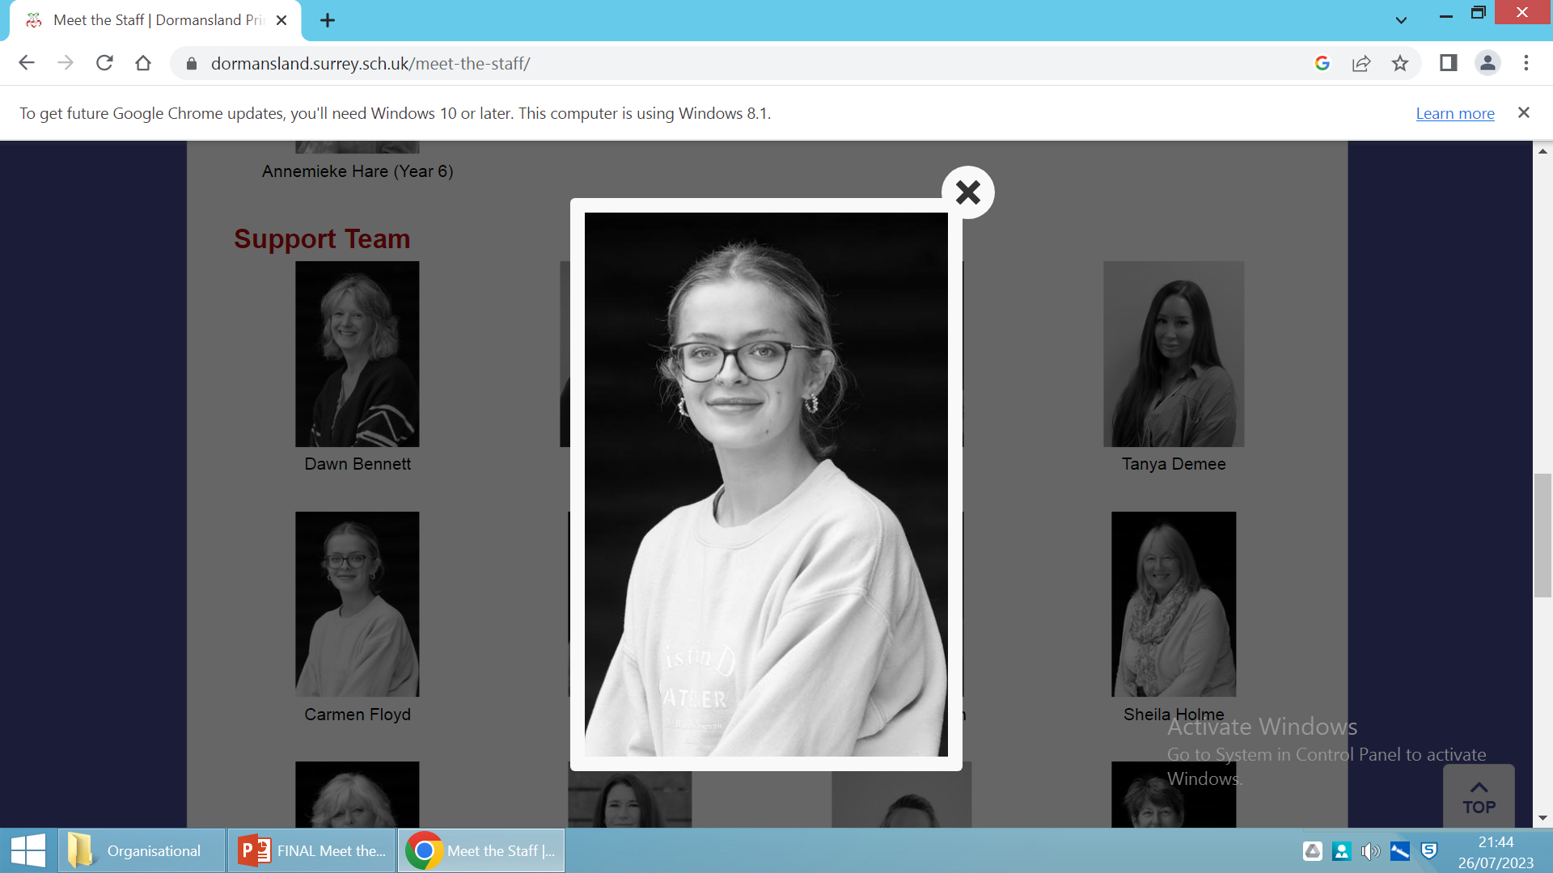
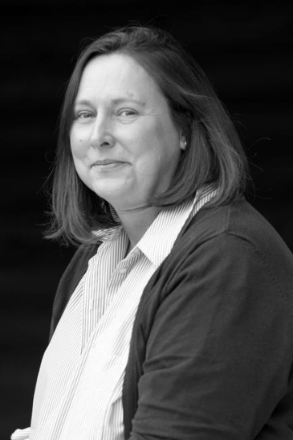
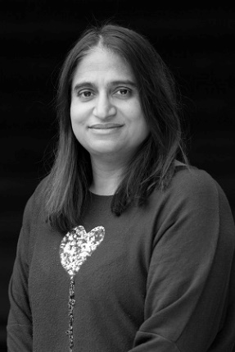
Adults we work with…
Year 3
Mrs Pollard CT: (Tues-Fri)
Mr Cook CT: (Mon & Tues pm)
Mrs Wood TA: (Mon-Thurs)
Miss Floyd TA: (Mon-Wed)
Mrs Higginson TA: (Thurs & Fri)
Ms Degia TA: (Tues, Wed & Fri)

Slide 3
A typical day in Year 3:
8:40am 9:00am 10:30am 11:00am 12:00pm 12:30pm 1:20pm 2:15pm 3.15pm
Monday (MC) | Morning challenge and register | Whole School Assembly | Maths | 10:30am KS2 Break | English | Whole Class Reading | Lunch | PE (Outdoor) |  | Computing
Tuesday |  | Maths | PSHE | 10:30am KS2 Break 10:45am Assembly | English | Whole Class Reading |  | STEM – Science
Wednesday |  | Maths | Music | 10:30am KS2 Break 10:45am Singing Assembly | English | Whole Class Reading |  | History/Geography
Thursday |  | Spelling Test | Maths | 10:30am KS2 Break 10:45am Celebration Assembly | Spelling test English | French |  | Whole Class Reading | PE (Indoor)
Friday |  | Maths | RE | 10:30am KS2 Break | English | Whole Class Reading |  | The Arts - Art / STEM DT |  |  | 2:50pm HP Assembly

Slide 4
Year 3 Learning - Autumn Term:
History – Stone Age
Geography - Volcanoes
Life in the Stone Age.
Skara Brae and Stone Henge.
Who was the Amesbury Archer?
Iron Age and Bronze Age.
Artefacts.
Hunter gathering.
How the earth is constructed.
Mountains.
Volcano formation.
Volcanic eruptions.
Earthquakes.
Types of rocks.

Slide 5
PE Lessons
Year 3 PE days = Mondays (outdoors) and Thursdays (indoors)
Wear PE kit to school.
Correct clothing in line with school uniform policy – shorts/skorts, joggers, house team coloured t-shirt, trainers.
No earrings or tape to cover them up.

Slide 6
Reading Expectations…
Reading record – checked regularly over the week.
Adult or child to record (e.g. independent reading).
10 mins each day.
Housepoints for reading.
Bug Club.
Responsible for changing their book.
Assessments throughout the year.

Slide 7
Spellings…
Year ¾ statutory word list (split between year groups).
Spelling rules.
Spelling test each week.
Continue using and applying phonics.
Edshed.
Spelling journal and spelling fluency books in school.

Slide 8
Spelling Arrangements…
New spellings handed out on Friday in red home learning book.
Practised throughout the week at home and school.
Tested on Thursday – BRING BOOK BACK!
Marked ready for new spellings to be handed out on Friday.

Slide 9
Home Learning…
Reading 5x week.
Spellings in red book.
Edshed spellings assignment.
Times Tables Rockstars.
Home learning grid.

Slide 10
Uniform…
Black/blue/grey trousers/skirts.
White polo/shirt.
Navy/blue cardigan or jumper.
Grey, navy, black or white socks.
Black school shoes.
Earrings – small studs that must be removed by child for PE.
Long hair (shoulder length and below) must be tied back at all times, hair ties and headbands should be small and discreet in school colours only.
Children should not wear make up, nail polish or temporary tattoos in school.
Please ensure that ALL uniform and equipment is named.

Slide 11
Communication
Please email info@dormansland.surrey.sch.uk with subject as FOA: ‘teacher name’
We will then get in touch with you at the earliest opportunity.
We are always available on the playground at the end of the school day once the class has been dismissed.
For small non-urgent matters, notes could be put in the reading diaries.
Please also check messages on the class webpages, SCOPAY, Marvellous Me and school newsletters.

Slide 12
Others…
Parent readers.
Pieces of fruit or plain breadsticks for snack.
Equipment.
Permission slips, medical and collection arrangements.

Slide 13

Any Questions?

